Slide 1
University of Wrocław
Institute for Theoretical Physics
dr Remigiusz Durka 2013

Slide 2
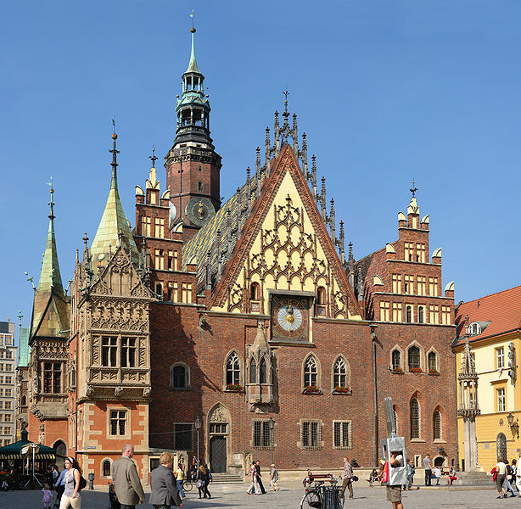
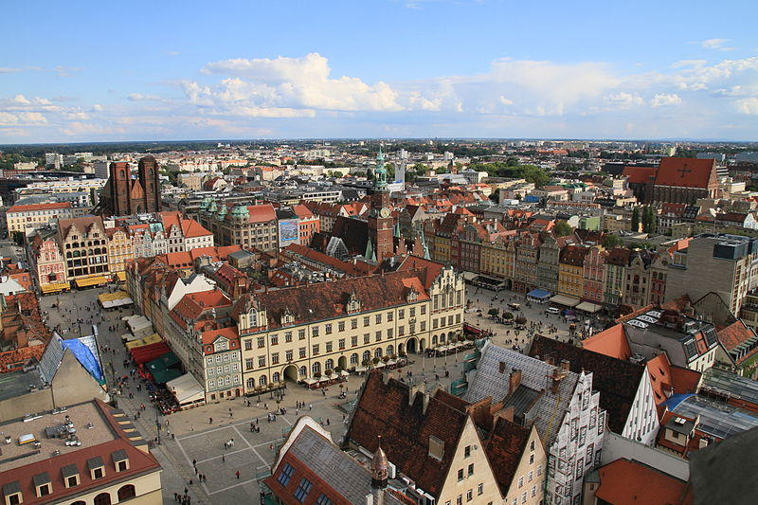
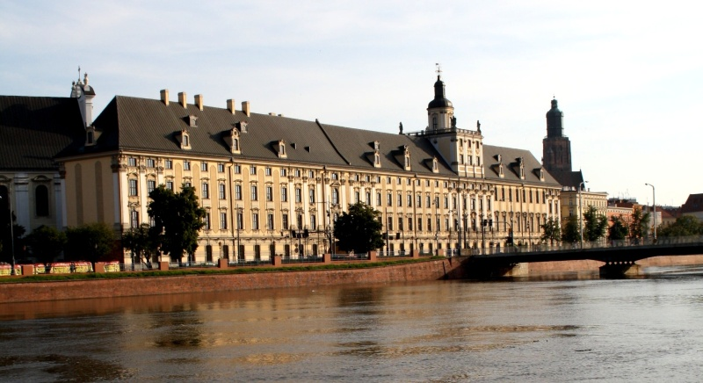
Wrocław
Notes:
Wrocław is the fourth biggest city in Poland. City contains 12 islands and 112 bridges. It is the economic, cultural and intellectual capital of Lower Silesia. Many is calling Wrocław „the city of meetings”.

Slide 3
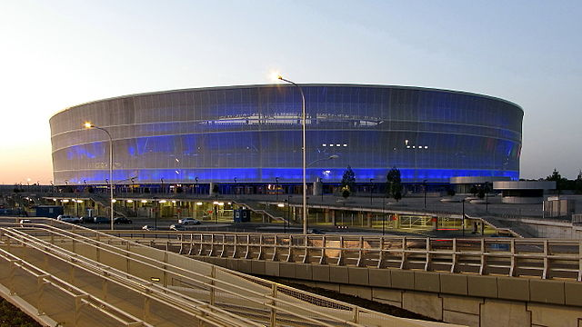
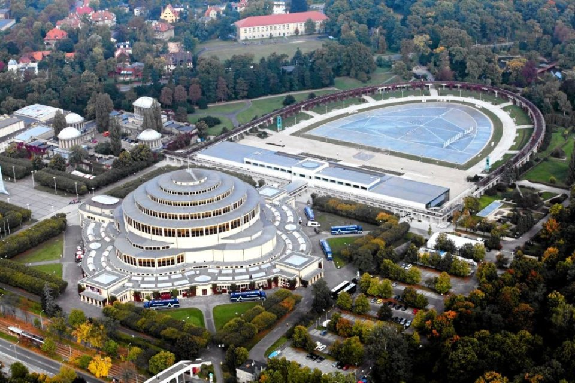
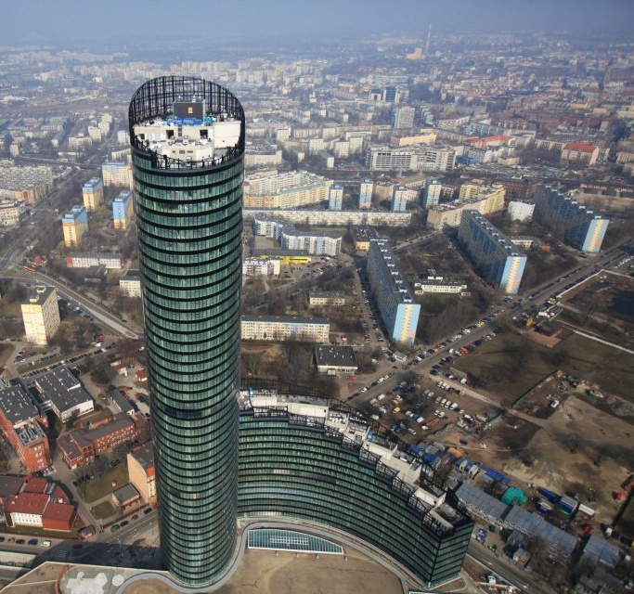
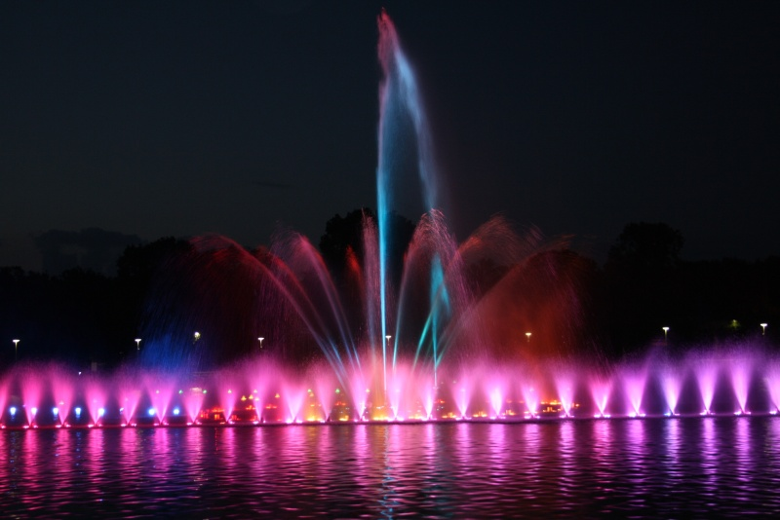
http://en.wikipedia.org/wiki/Wroc%C5%82aw#Gallery
Notes:
Wrocław was the host of Euro 2012 has been selected as a European Capital of Culture for 2016. Here you can see present landmarks: Centenial Hall, Multimedial Fountain, Sky Tower

Slide 4
Nobel Prize
Max Born
Philipp Lenard
Eduard Buchner
Paul Ehrlich
Erwin Schrödinger
Theodor Mommsen
Otto Stern
Fritz Haber
Friedrich Bergius
Notes:
Few years ago Wrocław celebrated 300 years of the existance of the University. There were nine Nobel Prize winners associated with the University of Wrocław (in the past called Schlesische Friedrich-Wilhelms-Universität zu Breslau). Today the University of Wrocław is the largest university in the region and teaches over 40,000 students and around 1300 doctoral students at 10 Faculties. 9000 students graduate from the University every year.

Slide 5
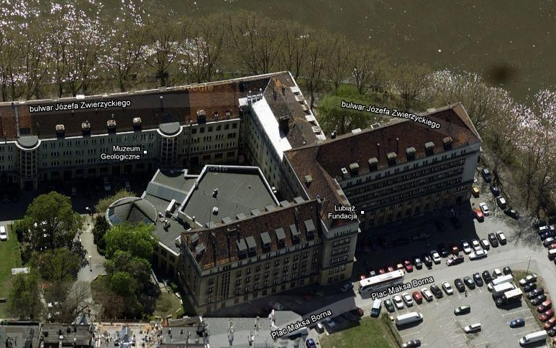
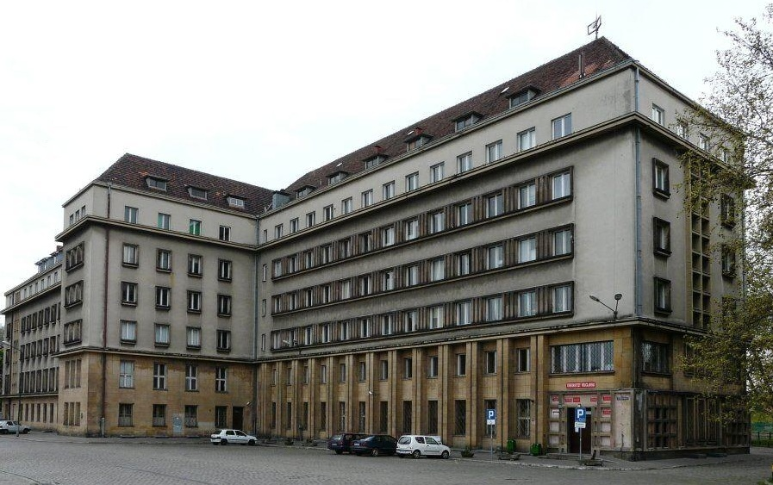
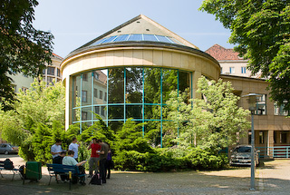
Institute of
Theoretical Physics
http://www.ift.uni.wroc.pl
Instytut Fizyki Teoretycznej (IFT)
FacuLty of Physics and Astronomy
wfa.uni.wroc.pl
Address Max Born Square 9
50-204 Wroclaw

Slide 6
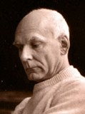
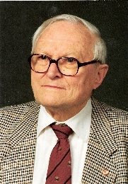
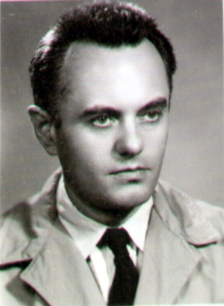
The Institute Founding Fathers
Jan Rzewuski (1916-1994)
Jan Łopuszański (1923-2008)
Roman Ingarden (1920-2011)
Haag-Łopuszański-Sohnius theorem
All Possible Generators of Supersymmetries of the s Matrix (over 700 citations)

Slide 7
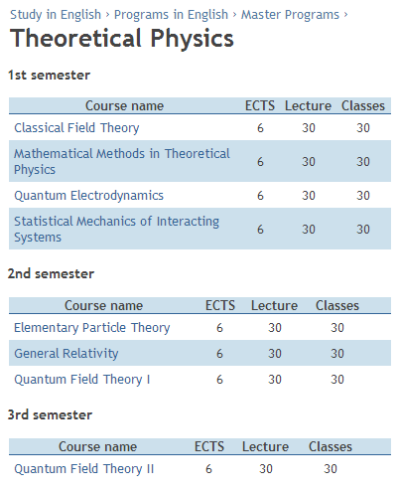
maSter Studies University of Wrocław
.
+ Specialized and Monographic Lectures
There are several proposals of these lectures changing from year to year.
Subjects and detailed programs depend on students' interest and current scientific activities of the research groups.
http://international.uni.wroc.pl/en/study-english/programs-english

Slide 8
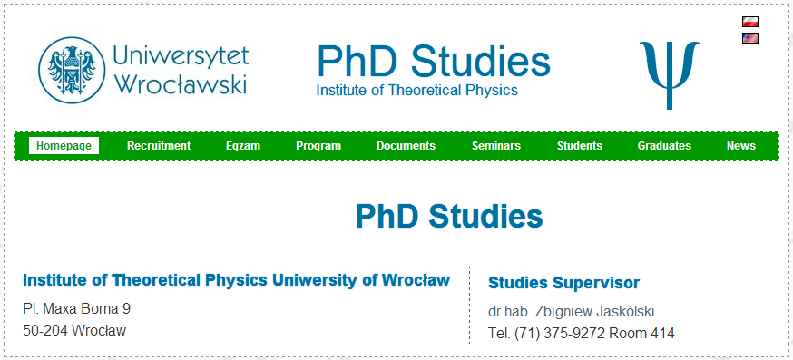
PhD Studies
Mariusz Adamski
Tomasz Golan
Jarosław Gołembiewski
Marek Gwóźdź
Jakub Jankowski
Łukasz Juchnowski
Michał Kosztołowicz
Paweł Laskoś-Grabowski
Rafał Łastowiecki
Marek Miller
Piotr Nyczka
Grzegorz Pamuła
Adam Strycharski
Michał Szcześniak
Sebastian Szkoda
Tomasz Trześniewski
Agnieszka Wergieluk
Aneta Wojnar
Jakub Żmuda
http://sd.ift.uni.wroc.pl/en

Slide 9
Condensed Matter Theory and Statistical Physics
Complex Systems and Nonlinear Dynamics
Mathematical Methods in Physics
Elementary Particle Theory
Neutrino Physics
Field Theory
Janusz Jędrzejewski
Katarzyna Sznajd-Weron
Lech Jakóbczyk
Jan Sobczyk
Zbigniew Haba
Ludwik Turko
Fundamental Interactions Theory and Quantum Gravity
Jerzy Kowalski-Glikman
Divisions in our Institute

Slide 10
Fundamental Interactions Theory and Quantum Gravity
Notes:
Research topics
The staff of the Division carries research on various approaches to fundamental theory of nature. The structure of quantum spacetime symmetries, non-commutative geometry , deformed symmetries and quantum groups, quantum theory of gravity, twistorial and supertwistorial models, string theory and conformal field theory, and detection of gravitational waves are investigated.

Slide 11
members
Fundamental Interactions Theory
and
Quantum Gravity
Jerzy Lukierski
Andrzej Borowiec
Zbigniew Jaskólski
Andrzej Frydryszak
Arkadiusz Błaut
Marcin Daszkiewicz
Remigiusz Durka
Francesco Cianfrani
Jerzy Kowalski-Glikman
Paulina Suchanek
Giacomo Rosati
Michał Kosztołowicz
Tomasz Trześniewski
Aneta Wojnar

Slide 12
Research Subjects
Kappa-Poincare symmetry, Doubly Special Relativity
Jaskólski, Suchanek
Geometric methods in field theory
Twistorial and supertwistorial formalisms
Gravity models, supergravity
Data analysis for gravitational waves detectors
Field theory on non-commutative spacetime
Cosmological models and the problem of dark matter and dark energy
Conformal and supeconformal field theories in 2-dimensions
Borowiec
Borowiec
Kowalski-Glikman, Lukierski, Borowiec
Kowalski-Glikman, Lukierski
Błaut
Kowalski-Glikman, Durka, Lukierski
Lukierski, Frydryszak
Kowalski-Glikman, Rosati
Relative Locality
Cianfrani
Loop Quantum Gravity and Cosmology
Notes:
Keywords
Deformations of space-time symmetries, Quantum groups and supergroups, Twistors and supertwistors, Geometric and algebraic methods in mechanics and field theory, Conformal field theory, Quantum gravity, Gravitational waves.

Slide 13
Collaboration
ZIBJ Dubna
S. Fedoruk i E. Ivanov (Borowiec, Lukierski)
University of Turin
M. Ferraris, M. Francavigla (Borowiec)
Perimeter Institute
L. Freidel, L. Smolin (Kowalski-Glikman)
Rome La Sapienza
G. Amelino-Camelia, M. Arzano (Kowalski-Glikman, Rosati)
University of Valencia
J.A, de Azcarraga , Jose M. Izquierdo (Lukierski)
Barcelona University
Joaquim Gomis (Lukierski)
IBPF, Rio de Janeiro
Francesco Toppan (Lukierski)
Moscow
V. Tolstoy (Borowiec, Lukierski)
Mathematics Inst. PAN Warsaw
A. Królak (Błaut)
AEI Potsdam, Germany
S. Babak (Błaut)
Jagielloński University
L. Hadasz, P. (Jaskólski); M. Szydłowski (Borowiec)

Slide 14
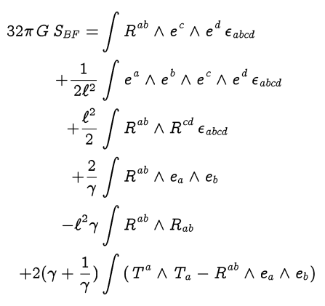
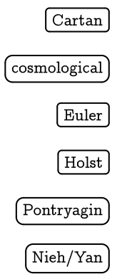
MY RESEARCH
Deformed topological BF theory as gravity theory
Immirzi parameter
AdS black hole thermodynamics
supergravity
My webpage http://www.ift.uni.wroc.pl/~rdurka

